Slide 1

Proposal for Microsoft Studios
Jeffery, Matthew, and Grace

Slide 2
Summary
A visual and descriptive analysis of top performing movies reveals recommendations to Microsoft about the types of films they should produce in their new feature film studio:
Focus efforts on blockbuster and animation film types
Produce both live action and animated movies, giving the adventure and fantasy genres top priority
Include strong consideration to international audiences in the production process
Notes:
Good day. My name is Jeff, and along with Grace and Matt, we have been tasked to advise Microsoft in making key decisions regarding the establishment of your new film production studio, primarily dealing with the genres of movies that offer the best opportunity for consistently high box office performance. Our analysis today supports recommendations centered around producing blockbuster movies and animated movies, 3 highly popular genres, and thoughtful consideration to international audiences. On the next slide you’ll see the outline of today’s presentation

Slide 3
Outline
Business Problem
Data & Methodology
Recommendations
Notes:
Analysis of popular film genres and financial data shows that top-grossing films are centered around a few film types. Additionally, one studio group stands out as the creative leader in these genres. Your team at Microsoft can use this examination of the data as part of your toolbox to set visioning, hiring practices, property acquisition and advertising for your initial resource allocation. The next slide

Slide 4
Business Problem
Clarify the types and genres of films to be produced
Analyze costs and profits among various studios
Provide comparative review of domestic and worldwide data
Notes:
As you can see, we are focusing today on the task of narrowing what kinds of films you should make and ways to produce the best content with the highest bottom line. Now, Grace is going to talk about the data we used and our methodology

Slide 5
Data & Methodology
The datasets of this project are from the following websites:
Box Office Mojo
IMDB
The Numbers
Restricting the data to the last eleven years (2008-2018), we performed exploratory data analysis with visualizations to better understand the different information from the datasets
Notes:
In our research for this project, we focused on what it could mean for Microsoft to successfully start a film studio. We gathered data on top grossing films, what categories and genres they fall under and what studios produced them, to analyze its potential financial and reputational rewards.

Slide 6
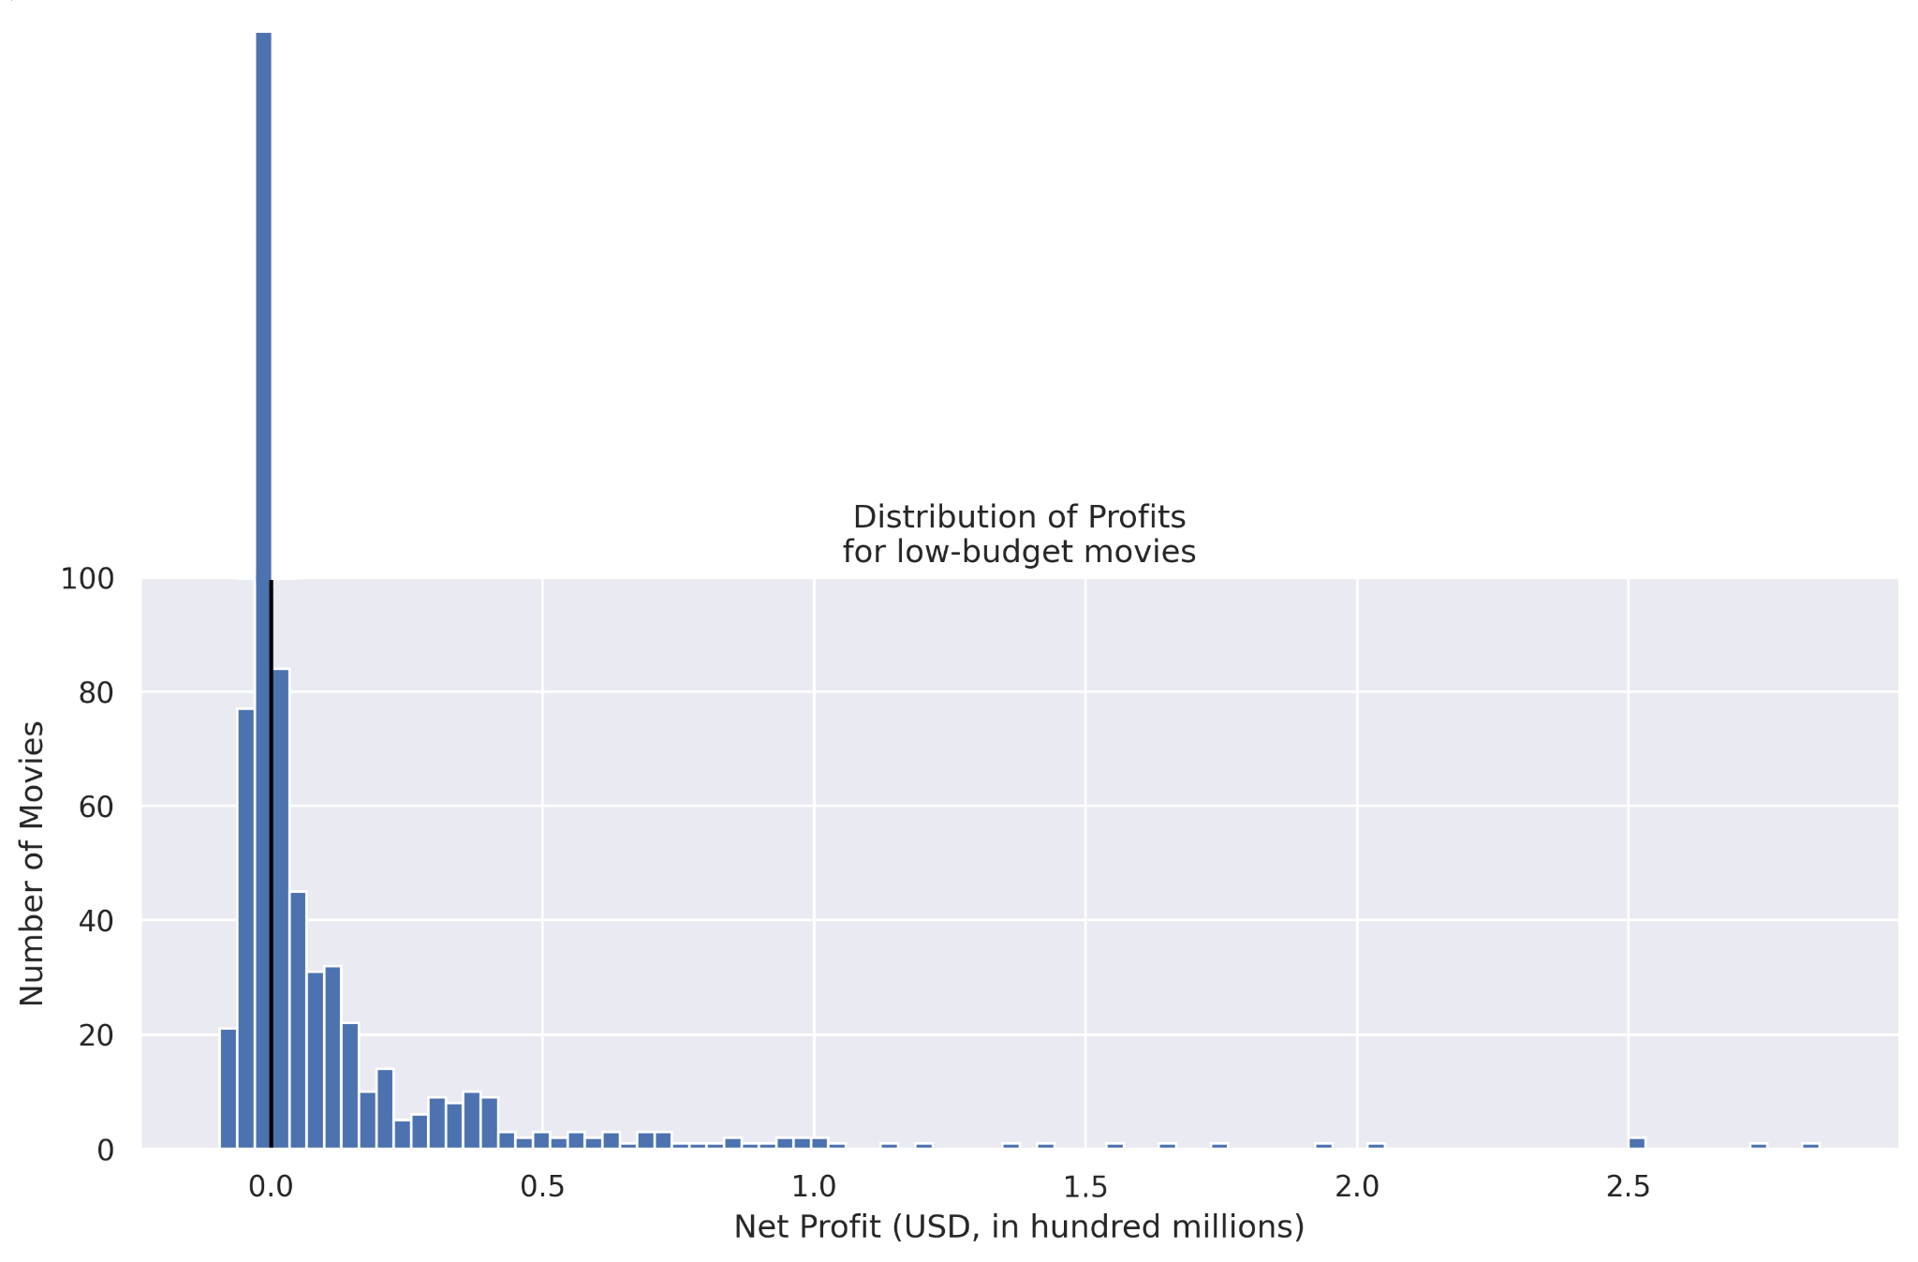
What budget levels are profitable?
And with what consistency?
Low Budget: < $10m
Middle Budget: $10m - $100m
Big Budget: > $100m
Notes:
It would be tempting to look at the list of top 100 movies by profit and base our entire analysis off of that. However, we think a potentially much more important metric than “most profitable” is “most often profitable.”
If we break movies down into categories by production budget, we see a very clear picture of what types of film budgets most frequently yield profits.
For instance, graphed here, we see the number of low-budget films in different profit brackets (to the left of the black line is negative net profit, to the right is positive). Notice that the largest single group made a negative net profit. In fact, only 56% of low-budget movies are profitable.
So is the story better with middle or big budget movies?

Slide 7
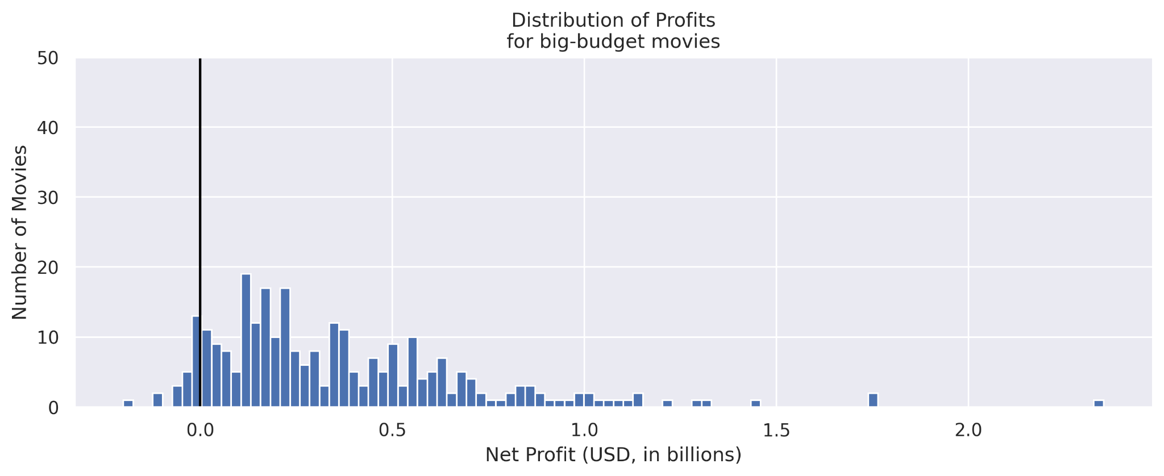
Profit Distribution for Big Budget Movies
Only 56.21% of low budget movies are profitable.
73.94% of middle budget movies are profitable.
93.29% of big budget movies are profitable.
Notes:
Yes, in fact. Middle budget movies fare decently better (74% are profitable), but, importantly, big-budget movies are in fact profitable more than 93% of the time.
Additionally, the median profit of big-budget films is an order of magnitude higher than middle-budget films, so we can confidently say that big-budget movies are the most profitable AND the most often profitable.
And we’ll see a similar result with genres, which Grace will talk about.

Slide 8
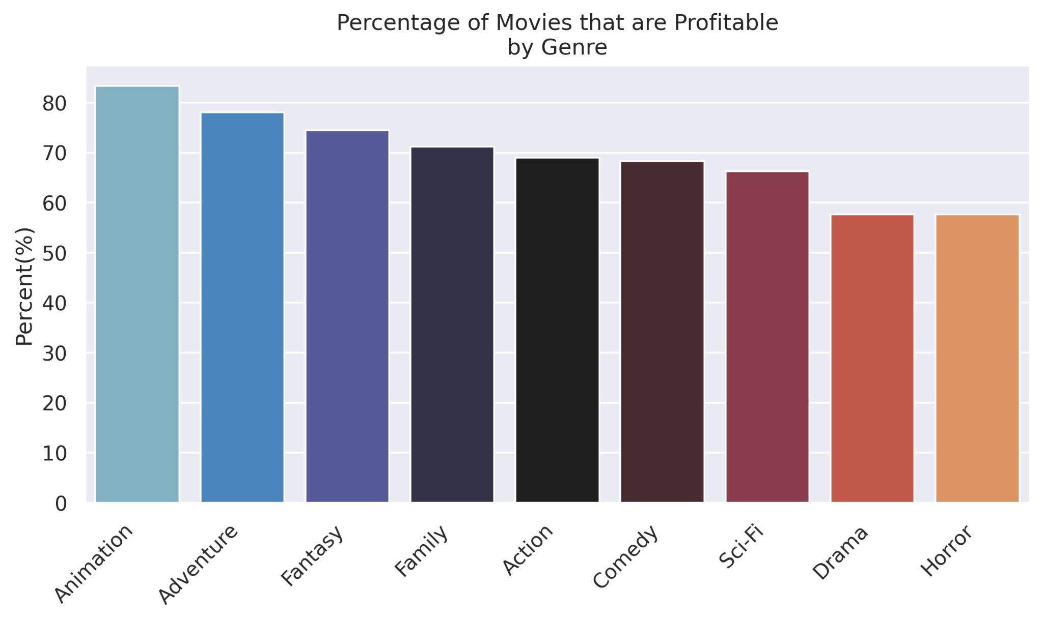
What Genres should Microsoft Studios focus on?
Notes:
According to this bar graph, we found that Animations are consistently profitable with 83.3% of films produced under this category yield profits
We found that the top three most consistently profitable genres below animation are adventure, fantasy and family movies
Moreover animation and adventure have the highest two median profits.

Slide 9
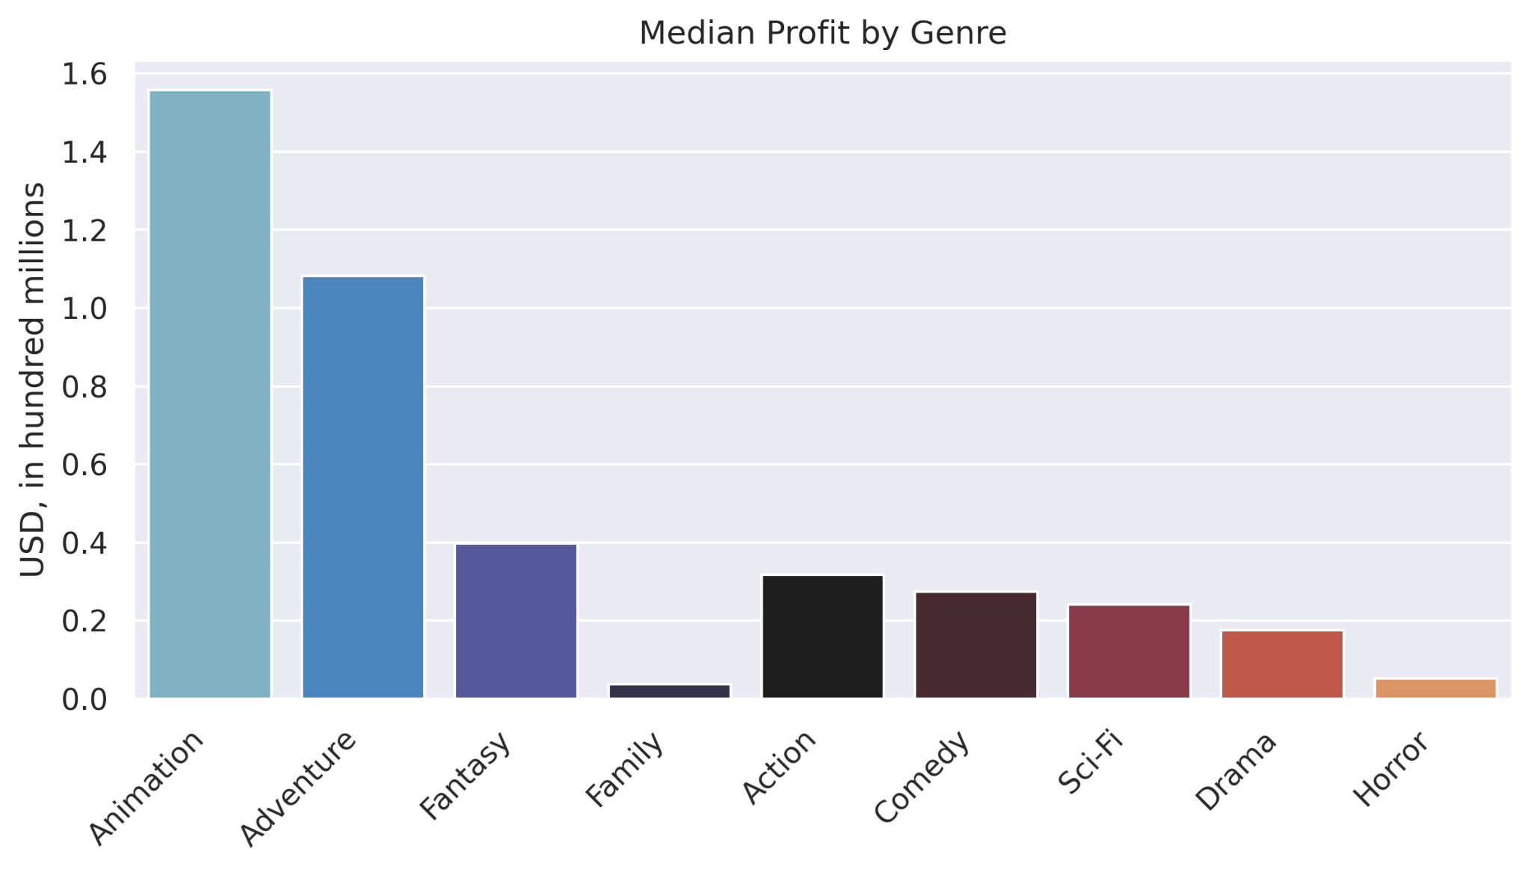
What Genres should Microsoft Studios focus on?
Notes:
Moreover, if we examine the median profits of each individual genre, we see that animation and adventure have the highest two median profits, by considerable margins.

Slide 10
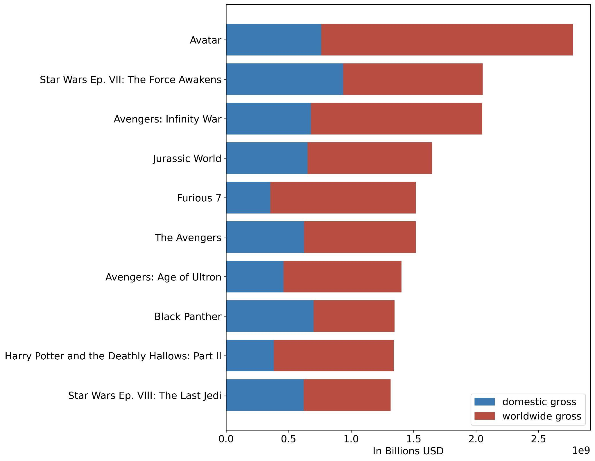
Top 15
Grossing Movies
2008 - 2018
Worldwide gross earnings represent a larger portion of total gross in most instances
13 of the top 15 films are in the action / adventure / fantasy genres
Notes:
Here we see the top grossing movies over 11 years - note the impact of worldwide earnings in the gross product

Slide 11
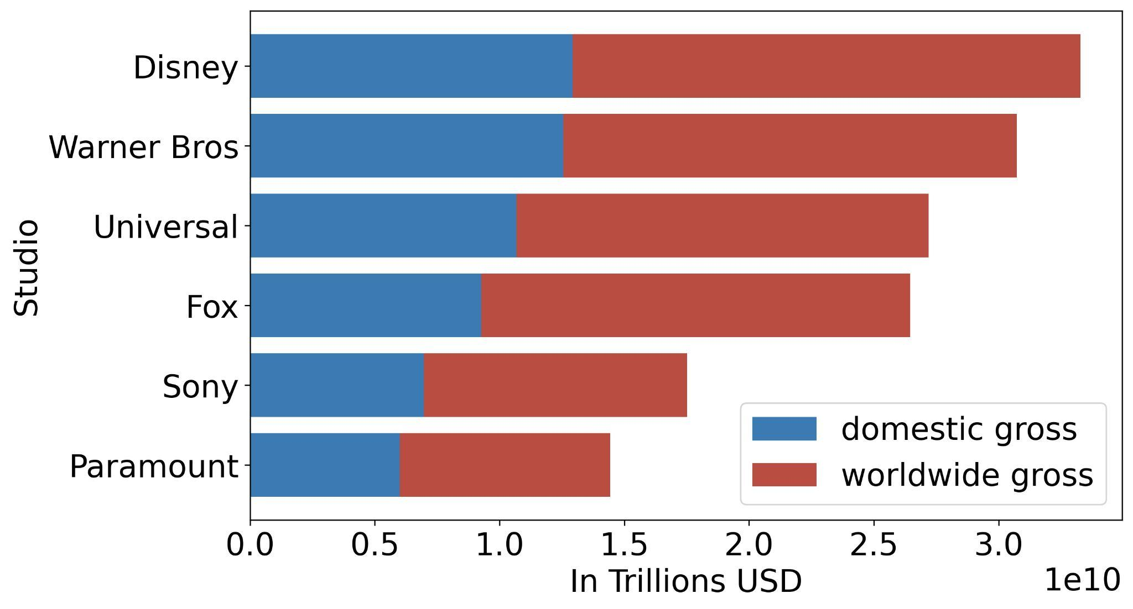
Top 4 Grossing Movie Studios - 2008 - 2018
Worldwide gross represents a majority portion of revenues in the leading studios
Notes:
Here’s the same type of chart grouped by top studios. Note again the prominence of the worldwide gross, and also Disney’s domination of this market

Slide 12
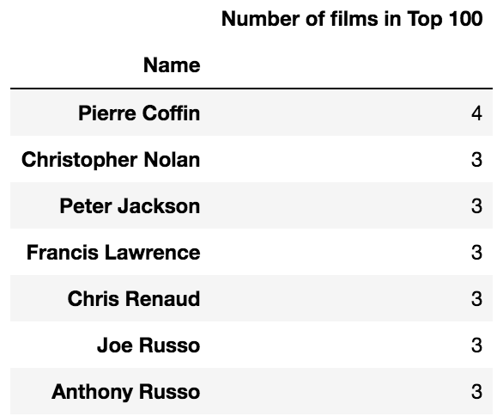
Top Directors - All Genres by Net Profit - 2008 - 2018
These are the directors that turn up the most often in the Top 100 most profitable films
Notes:
Here we see 7 most common directors in the 100 most profitable films. These are not the 7 most profitable directors

Slide 13
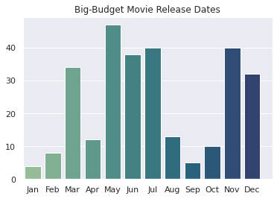
When should we release the movies?
Big budget movies are generally released in the summer and leading up to the holidays
Mid budget movies avoid the summer
Low budget movies avoid the holidays
Notes:
Another extremely useful analysis for determining release dates - summer and holidays are peak times for big budget films - the chart only address big budget movies, but note the quite sensible release dates for mid and low budget movies

Slide 14
Recommendations
Focus on big-budget tent-pole releases: they make more money, and they make it more often.
1
Open or acquire an animation arm for the studio. Focus on the same genres as the mainline studio: Adventure and Fantasy.
2
Always consider the international market and audience; they will generate the vast majority of your profits.
3
Notes:
-So to sum up, our recommendations are to
Focus on big-budget tent-pole releases: not only do they tend to be more profitable, but they also tend to more consistently be profitable in the first place.
Open or acquire an animation arm that focuses on the same genres as the mainline studio as a whole: adventure, fantasy, and family, as these are the most consistently profitable (and additionally, animation and adventure have the highest median profits of any genre by an order of magnitude).
In choosing scripts, stars, shooting locations, consider the impact or appeal to the international markets. They will generate the vae vast majority of your profits. Sometimes merely casting an actor from a particular market can bring in a considerable additional audience.
To this end, if you’re looking for a place to start, we recommend leveraging some of the intellectual property already held by Microsoft. A hypothetical film that meets all of our criteria would be a Minecraft movie. It could be animated and directed by someone like Pierre Coffin or Chris Renaud (both are directors of the Despicable Me series)
Thank you for your time. Any questions?

Slide 15

Questions?

